Slide 1
Expensive restaurant and health inspections scores.
Group 5
Weylin Lam
Delvin Milligan
Nancy Mathur
Christian Thomson

Slide 2
Our Hypothesis
Restaurants that are more expensive have higher health inspection scores.

Slide 3
Who cares?
Why we chose this topic
We wanted to know if price influences the outcome of a Health Inspection
What we found to be true is
Notes:
We believed that restaurants that cost more had better health inspection scores
We all deiced that the biggest thing we had in common was food.
Portland is a foody town
We like to eat
Perception of higher cost = better experience

Slide 4
Our process
Started to read the documentation
Tried to understand what information we got back
Changed our scope once we looked at the data in more depth
Decided on our data sources
County website
County CSV
Yelp API
Looked at Health Inspection scores / Price rating
Distribution of inspect to rating
Distribution of restaurants with similar scores

Slide 5
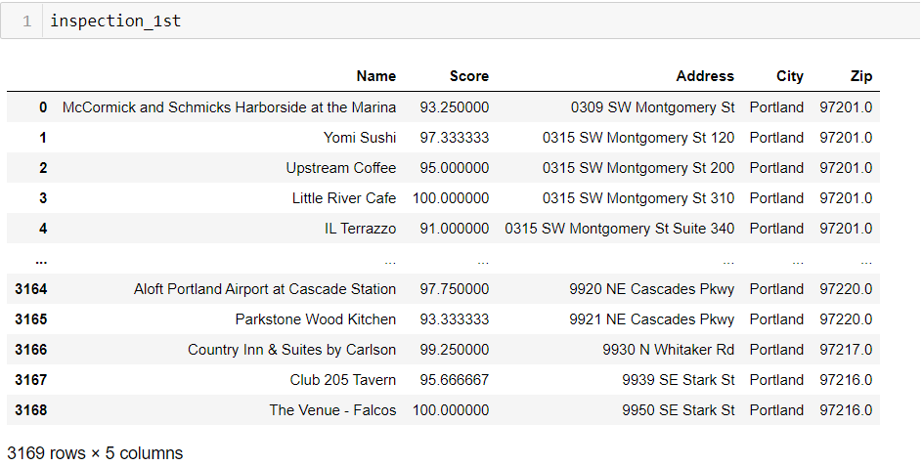
We got a CSV from the County
Notes:
We reach out to Multnomah County for Health inspection data
Got some info from the County via a CSV file
We found 4500 restaurants in Multnomah County

Slide 6
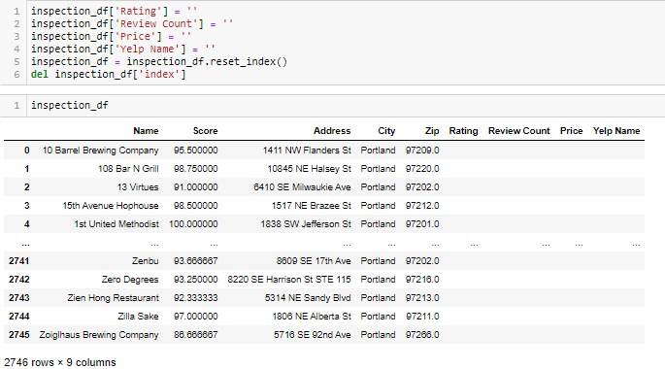
We needed more columns
Notes:
Used the API to find additional information
Used to populate information from API into our Data Frame.

Slide 7

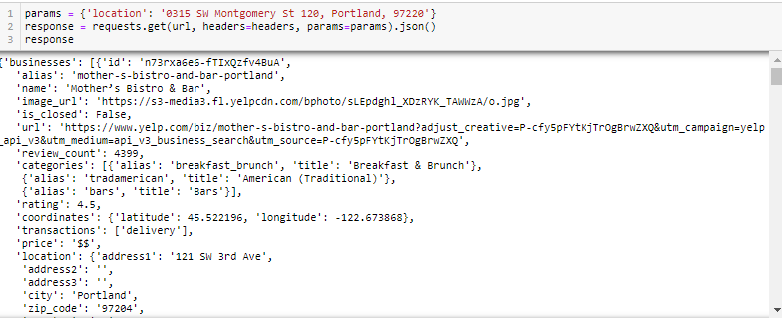
We used
Notes:
Started to use the physical address as a params in the Yelp API
Found the name might be a better choice

Slide 8
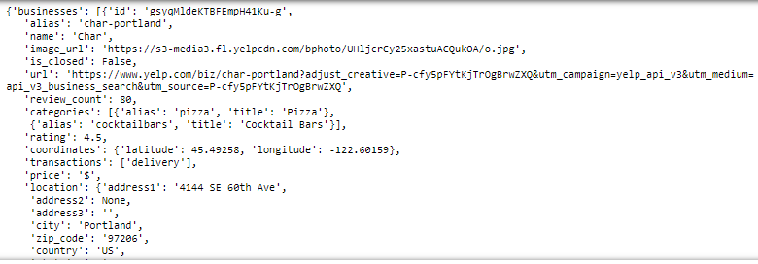
We changed direction
Notes:
Our results worked

Slide 9
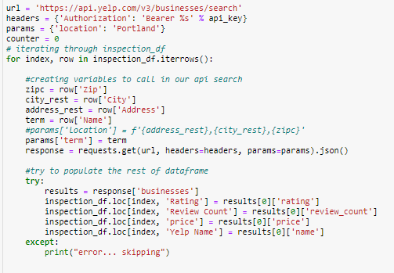
We asked the world for results

Slide 10
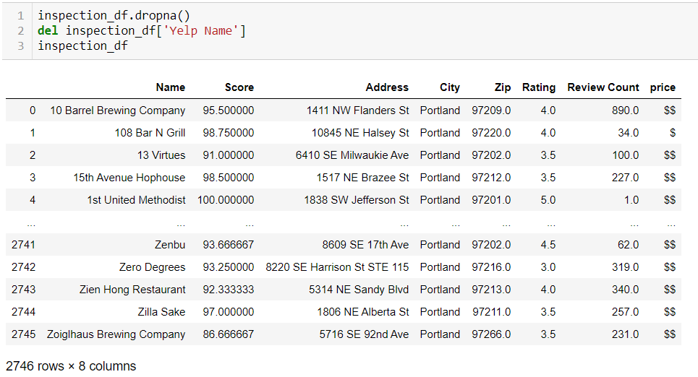
We added some data to columns

Slide 11
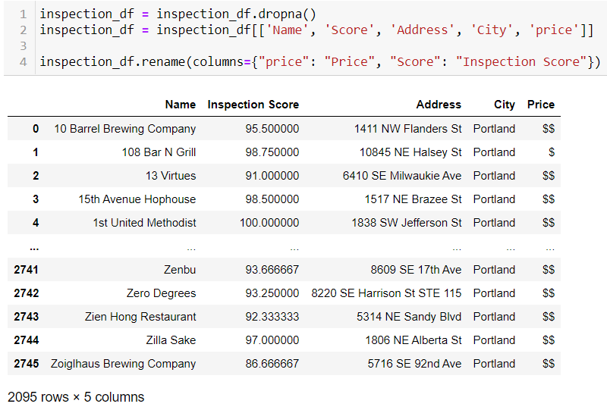
We got rid of rows with not enough info our Data is clean!

Slide 12
We started to look at our results
Graphically
Numerically
Figuratively

Slide 13
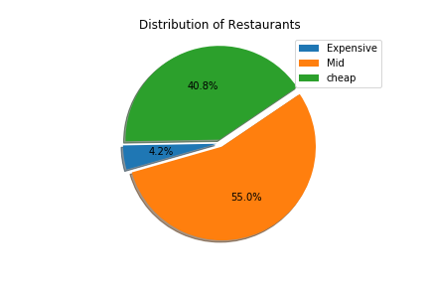
What was the first relationships we looked at?

Slide 14
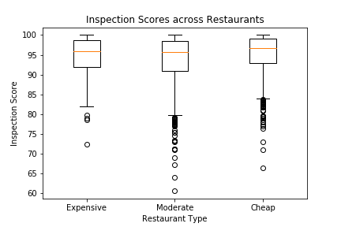

Slide 15
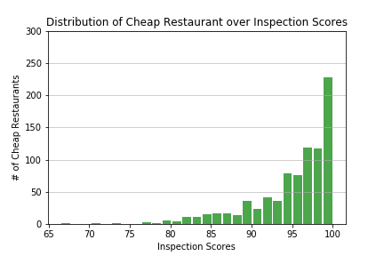
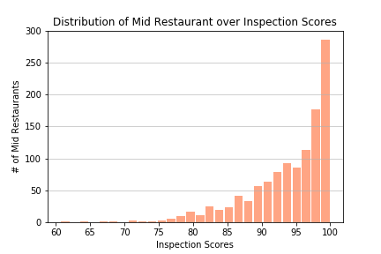
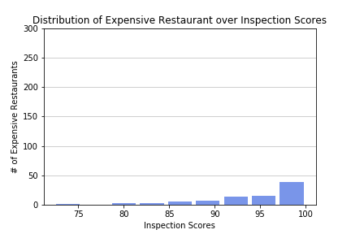

Slide 16
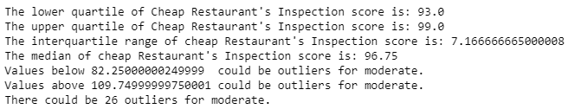
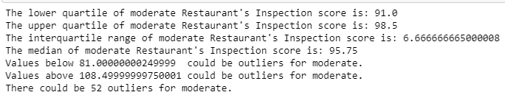
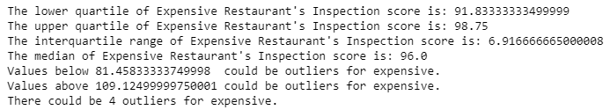

Slide 17
What it looked like
https://github.com/DCMilligan88/Project1Repo/blob/nancybranch/analysis_project1.ipynb

Slide 18
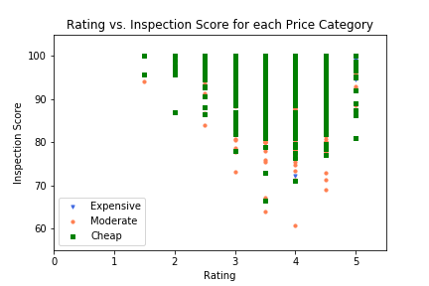
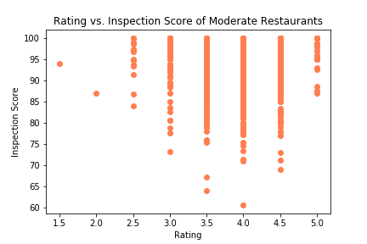
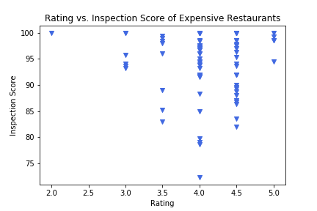
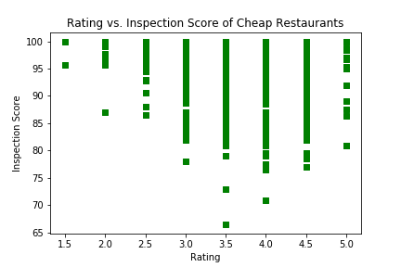
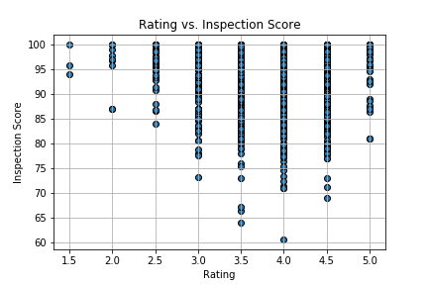
Didn’t think that would happen?

Slide 19
Why we are right if we are?
Our assumption was the more expensive a restaurant is the better the health score.
What we found was (X) of business with an expensive rating scored (X%) on a health inspection
We found that (X) business with less expensive rating scored (X%) on a health inspection
We found that (X) business with an average expense rate scored (X%) on a health inspection

Slide 20
Memories
Things that well
Things that did what they did
Things that became a pain

Slide 21
What do we wish we could have looked at
If we had more time
Normal distribution of health inspection to price category.
We focused on Portland not enough expensive restaurants.
More Data

Slide 22
Eureka!
Insights you had while exploring the data that you didn't anticipate
It just doesn't matter

Slide 23
Thank you for your time
Questions?

